Slide 1


7 - 9 October 2025 Vienna

Slide 2
Welcome, introduction, organization
Introductions of participants
Organizational details: WLAN: BMIMI-Guest
All documents available at https://github.com/IEHG/IEHG-Meeting-2025
please send your presentations to bernd.birklhuber@bmimi.gv.at)
All presentations will be published at https://ienc.openecdis.org (please inform, if you object)

Slide 3
Agenda (1)
Welcome, introduction of participants, organizational details
Update on the legal and organizational background and the status of implementation
Presentation of Inland ENC applications by private companies
Election of core group, ToR and list of members
Test charts for edition 2.6
Status of S-99, S-100, S-101 and other S-100 based products
Interoperability and S-98, S-403
Development of the S-401 main document
Development of the S-401 DCEG
Development of the S-401 Feature Catalogue
Development of the S-401 Portrayal Catalogue
Development of S-401 test cells
Development of a S-401 alert catalogue
Development of S-158:401 validation checks
S-57 to S-100 converter and conversion guidance
S-401 conclusions and timeline
Agenda

Slide 4
Agenda (2)
S-201, S-125 and S-402
Annual report to HSSC
Information documents on Inland ENCs
Future operation of ienc website and discussion forum
Any other business
Next meeting
Most important goal of this meeting is the adoption of an
edition 1.2.0 of S-401 that can be used for testing and as a basis for an edition 2.0.0 that could be adopted in 2026
Agenda

Slide 5
Time schedule
Tuesday, 7 October, to Thursday, 9 October
09:00 - 10:30 morning session
10:30 - 11:00 coffee break
11:00 - 12:30 continuation of morning session
12:30 - 14:00 lunch
14:00 - 15:30 afternoon session
15:30 - 16:00 coffee break
16:00 - 17:00 continuation of afternoon session
All times in UTC + 2 h

Slide 6
Common dinner
Wednesday, 8 October, 19:00
“Gasthaus Wild”, Radetzkyplatz 1, 1030 Wien
From the ministry: when exiting turn right into Radetzkystraße and walk to Radetzkyplatz. The restaurant is on the right side.
From Ruby Sofie Hotel: exit and turn right, turn right into the second road (Kollergasse), turn left into the third road (Lorbeergasse) and pass under the railway, then turn right on Obere Viaduktgasse and walk to Radetzkyplatz, where the restaurant is on your left side (10 min walk)

Slide 7
Inland ENCs and the Inland ENC Harmonization Group (IEHG)
Update on the legal and organizational background and the status of implementation
Inland ENCs
Brazil
- Planned (names of waterways & no. of km)
- Completed (names of waterways & no. of km)
- Available (e.g., from website)
China
Europe
Russian Federation
USA
Overview

Slide 8
New participants
Presentations by the new participants about their river/inland waterway network, navigation and cartography
India

Slide 9

Open action points
Please provide an email to bernd.birklhuber@bmimi.gv.at containing updates to the information on Inland ENC coverage [offline version]
Please check also the list of international and national organizations on the website and inform bernd.birklhuber@bmimi.gv.at about necessary updates

Slide 10
Inland ENC applications
SevenCs
List of IENC applications:
https://ienc.openecdis.org/links [offline version]
Esri
IIC Technologies
Navico
Periskal

Slide 11
Open action points
The IEHG website contains also a list of both National Organizations and Private Companies involved with IENCs [offline version] If not listed, please provide URL to bernd.birklhuber@bmimi.gv.at for inclusion on the website
Denise / Mark - Double-check IIC Technologies listing – verify that “IENC Production Software” is the best category

Slide 12

The Inland ENC Harmonization Group
Objective: to develop and to maintain a harmonized standard for Inland Electronic Navigational Charts (IENCs) suitable for inland navigation that is based on the standards of IHO for ‘maritime’ ENC
Guiding principle: to agree upon specifications for Inland ENCs that are suitable for all known inland ENC data requirements for safe and efficient navigation on inland waterways
Notes:
Now let me introduce the Inland ENC Harmonization Group (IEHG):
The Objective of IEHG is to develop and to maintain a harmonized standard for Inland Electronic Navigational Charts (IENCs) suitable for inland navigation that is based on the standards of IHO for ‘maritime’ ENC The Goal is to agree upon specifications for Inland ENCs that are suitable for all known inland ENC data requirements for safe and efficient navigation. At the moment all European countries with a connected inland waterway network, the Russian Federation, the United States of America, Brazil, the Peoples Republic of China and the Republic of Korea are actively participating in IEHG.
It is further intended that IENC standards meet the basic needs for Inland ENC applications, worldwide.

Slide 13
IEHG - recognition
As the competent international technical group on Inland ENC technical standards development, implementation and maintenance, IEHG is recognized by:
Europe - European Union and the Central Commission for Navigation on the Rhine
North America – US Army Corps of Engineers
Russian Federation - Russian Ministry of Transport
Brazil, Peru and Venezuela – Hydrography and Navigation Services
Asia – Transport Research Institute of the Ministry of Transport of PRC and KHOA of Republic of Korea
International Hydrographic Organization (IHO)
Because there are several countries with Inland Navigation that are not Member States of IHO, IEHG does not intend to become a member of IHO
Instead, IEHG supports, advises and provides input to IHO regarding Inland ENC matters as a recognized NGIO
Notes:
IEHG is not an international organization like IHO, but it is recognized by
The European Union, the Central Commission for Navigation on the Rhine (CCNR),
The US Army Corps of Engineers,
The Russian Ministry of Transport,
The Directorates and Services for Hydrography and Navigation of the Brazilian Navy, Peru and Venezuela
The Ministry of Transport of the Peoples Republic of China, the Korean Hydrographic and Oceanographic Administration and
the International Hydrographic Organization (IHO).
Since there are several countries with Inland Navigation that are not Member States of IHO, IEHG does not intend to become a member of IHO.
Instead, IEHG supports, advises and provides input to IHO regarding Inland ENC matters.

Slide 14
IEHG – recognition (2)
In 2009, IEHG has been recognized by IHO as a Non Governmental International Organization (NGIO) with observer status
Current members of IEHG are all European countries with connected inland waterways (17), Russian Federation, USA, Brazil, China, Republic of Korea, Peru and Venezuela
Notes:
IEHG has been recognized by IHO as a Non Governmental International Organization (NGIO) with observer status in 2009.
Current members of IEHG are the European countries with a connected inland waterway network, the Russian Federation, the United States of America, Brazil, the Peoples Republic of China, the Republic of Korea, Peru and Venezuela. But of course IEHG welcomes every country with inland waterways.

Slide 15
IEHG – composition and organization
Composition - IEHG is a combined government/non-government technical group that works towards the development of international standards meant to facilitate the implementation of inland electronic charting and navigation, worldwide
Regions – IEHG regions are comprised of countries within a continent (North America, South America, Asia) or a recognized social-economic region (Europe, Russian Federation).
Organization – By simple majority vote, chairpersons, vice-chairs and technical coordinators are elected.
ToR

Slide 16
IEHG – membership
All the members of IEHG should have current expertise in the field of Inland ENCs.
Participants – Anyone who is involved in the production of Inland ENCs or the production of Inland ENC applications and representatives of user groups can participate in IEHG, make proposals and take part in the discussions.
Members - Representatives of competent authorities involved in the provision of Inland ENCs are entitled to become members. If proposed by a competent authority, membership can also include expert contributors.
ToR

Slide 17
IEHG – procedures
Meeting Schedule - The IEHG normally meets once per year. If required, there can be an additional meeting or the meeting can be postponed.
Discussion Forum - The IEHG uses the internet as a discussion platform in the time between the meetings. Every participant of IEHG is entitled to start a new discussion topic and to take part in discussions about Inland ENCs.
Task Groups - The IEHG may decide to form a task group for the drafting of specific proposals.
Proposal Submission and Review: see Terms of Reference
ToR

Slide 18
IEHG – formalization of standards
The IEHG submits Inland ENC standards for formalization to:
Interested international organisations like IHO, the European Commission (EC), the Central Commission for Navigation on the Rhine (CCNR), the Danube Commission (DC), the Economic Commission for Europe of the United Nations (UN/ECE) and the Mekong River Commission
National competent authorities (e.g., United States Army Corps of Engineers (USACE), Directorate of Hydrography and Navigation of the Brazilian Navy (DHN), Russian Ministry of Transport)
ToR

Slide 19
What can IEHG do for you?
Europe had developed an Inland ENC standard based on Edition 3.0 of S-57 (with inland specific amendments)
Edition 3.1 of S-57 used the same enumerations for different purposes
The “European Inland ENC standard” became incompatible with the maritime standard, had to be revised, and all existing Inland ENCs had to be corrected
This was an update without backward compatibility!
IEHG and the use of the Product Specification for Inland ENCs guarantees that all inland specific elements are taken into account by IHO for new developments

Slide 20
What can IEHG do for you? (2)
IEHG has established an Inland domain in the S-100 registry and a S-401 Product Specification: S-100 based ECDIS and ECS on maritime vessels will be able to read and display Inland ENCs correctly (even if they are not allowed to use S-401 within SOLAS area)
IEHG provides the possibility to participate in the developments of IHO
IEHG provides a forum for chart producers and application builders for exchange of experiences and knowledge

Slide 21
Involving end users
Involvement of end users in the development of S-401, especially regarding portrayal (e.g. which symbols, priority of information, …) would be beneficial
“Representatives of user groups” can become participants of IEHG and can participate in discussions on the forum
Individual boatmasters cannot become participants of IEHG according to the Terms of Reference
But we can invite them to participate in the discussion forum
Please inform some boatmasters who are experienced users of Inland ENCs

Slide 22
Election of the Core Group
By simple majority vote, chairpersons, vice-chairs and technical coordinators are elected.
Chair – Two persons (co-chairs) each from a different region. Only representatives of waterway authorities can become chairpersons.
One vice-chair from each region, which is not already a chair.
Technical Coordinators - One technical coordinator for each region.
Core Group – The two Chairs, the vice-chairs and Technical Coordinators.
The S-100 representatives are also part of the Core Group
ToR

Slide 23
Election of chairs
Chair – Two persons (co-chairs) each from a different region. Only representatives of waterway authorities can become chairpersons.
One vice-chair from each region, which is not already a chair
Current co-chairs: Denise LaDue (USACE, North America) Bernd Birklhuber (BMIMI of Austria, Europe)
Current vice-chairs: Vitor Pimentel, retired (DHN, South America) Qun Gu (WTI, Asia)
Proposals for the coming period?
Alves ARAUJO (DHN, South America)

Slide 24
Election of technical coordinators
Technical Coordinators - One technical coordinator for each region
Current technical coordinators: Cameron McLeay (CARIS USA, North America) Gaël Billet (Periskal Group, Europe) Vladimir Sekachev (STEOR-NSB LLC, Russia) ?? (South America) Li Liu (WTI, Asia)
Proposals for the coming period?

Slide 25
Election of representatives for S-100
IEHG has to nominate representatives for the registry management of S-100:
representatives as submitting organization (currently Denise LaDue and Gaël Billet)
representatives for the Domain Control Body (currently Denise LaDue and Gert Morlion)
represenatives for the Executive Control Body (currently Denise LaDue and Gaël Billet)
Proposals for the coming period?
ToR, Annex B

Slide 26
Amendment of the ToR
IEHG could check whether the ToR of IEHG need to be updated
ToR

Slide 27
Update of the Introduction of the EG
IEHG could check whether the Introduction to the Encoding Guide for Inland ENCs needs to be updated.

Slide 28
List of members and participants
The list is based on the ToR and is containing
Members
Expert contributors
Participants
Some e-mail addresses are no longer active and we can’t contact those persons
Please check if those persons can be deleted or if you know their new addresses
List of members

Slide 29
Adopted documents (S-57 based)
Product Specification for Inland ENCs, edition 2.6
Inland ENC Encoding Guide, edition 2.6.0
Inland ENC Feature Catalogue, edition 2.6
XML
Product Specification for bathymetric Inland ENCs, edition 2.6

Slide 30
Oben discussions edition 2.6 (Fairway 1)
Dear Colleagues,
I have a question for you regarding the use of fairway (FAIRWY) on your IENCs. In the US we have never used FAIRWY in our charts, we have only used depth areas (DEPARE), recommended tracks (RECTRC), and lateral buoys (BOYLAT) to encode our channels. It seems that FAIRWY might be a good option for us in certain instances, but I wanted to better understand how you encode FAIRWY in your regions.
Presently, we use different methods of showing the navigation channels in wide areas of the river. In on instance, on the Arkansas River, although the water is deep in areas outside of the “channel", we only show project depth areas for the channel itself (example 1). In other areas, we show project depth areas to their full extent (example 2). In both cases, the “channel" is defined by a RECTRC bounded by BOYLAT.

Slide 31
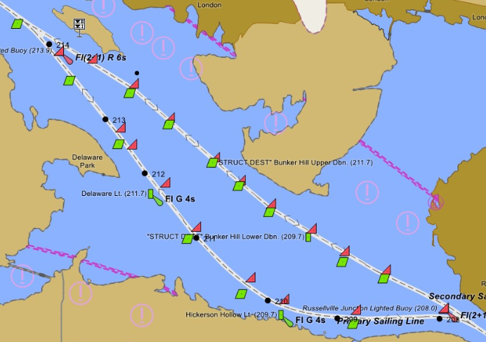
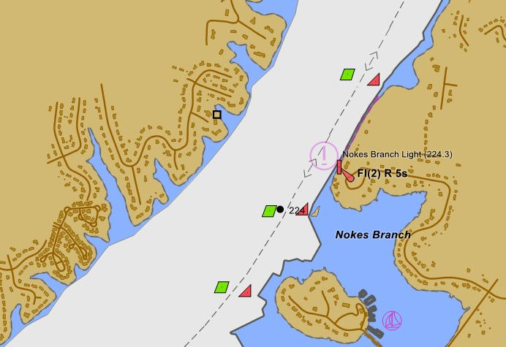
Oben discussions edition 2.6 (Fairway 2)
Example 1 Example 2

Slide 32
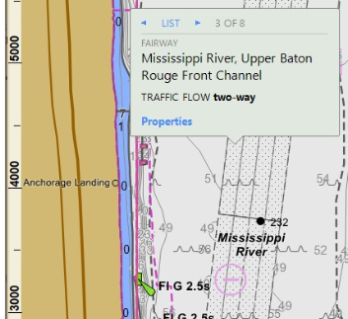
Oben discussions edition 2.6 (fairway 3)
I looked at a NOAA ENC for a portion of the Lower Mississippi River, and it only shows a FAIRWY in conjunction with a DRGARE (example 3).
Would you please share with me how you encode FAIRWY within your regions. Is a FAIRWY always a pre-established area, or is it subject to move based on hydrographic surveys?
Thank you in advance for your input.
Best regards,
Denise

Slide 33
Test charts for edition 2.6
The Recommended Validation Checks for Inland ENCs edition 2.6.1 (based on Special Publication S-58 Ed. 8.0.0 of IHO) have been adopted and published
Action point from last meeting: Germany to develop test charts for edition 2.6 as soon as a chart production tool for edition 2.6 is available
Status?

Slide 34
Status of S-99, S-100, S-101
S-100 has entered into force on 1st January 2010
S-100 edition 5.2.0 has been adopted in June 2024
S-100 Registry 3.1
S-99 edition 2.0.0 has been published in October 2022
S-101 edition 2.0.0 has been published in January 2025
All documents available at https://iho.int/en/standards-and-specifications

Slide 35
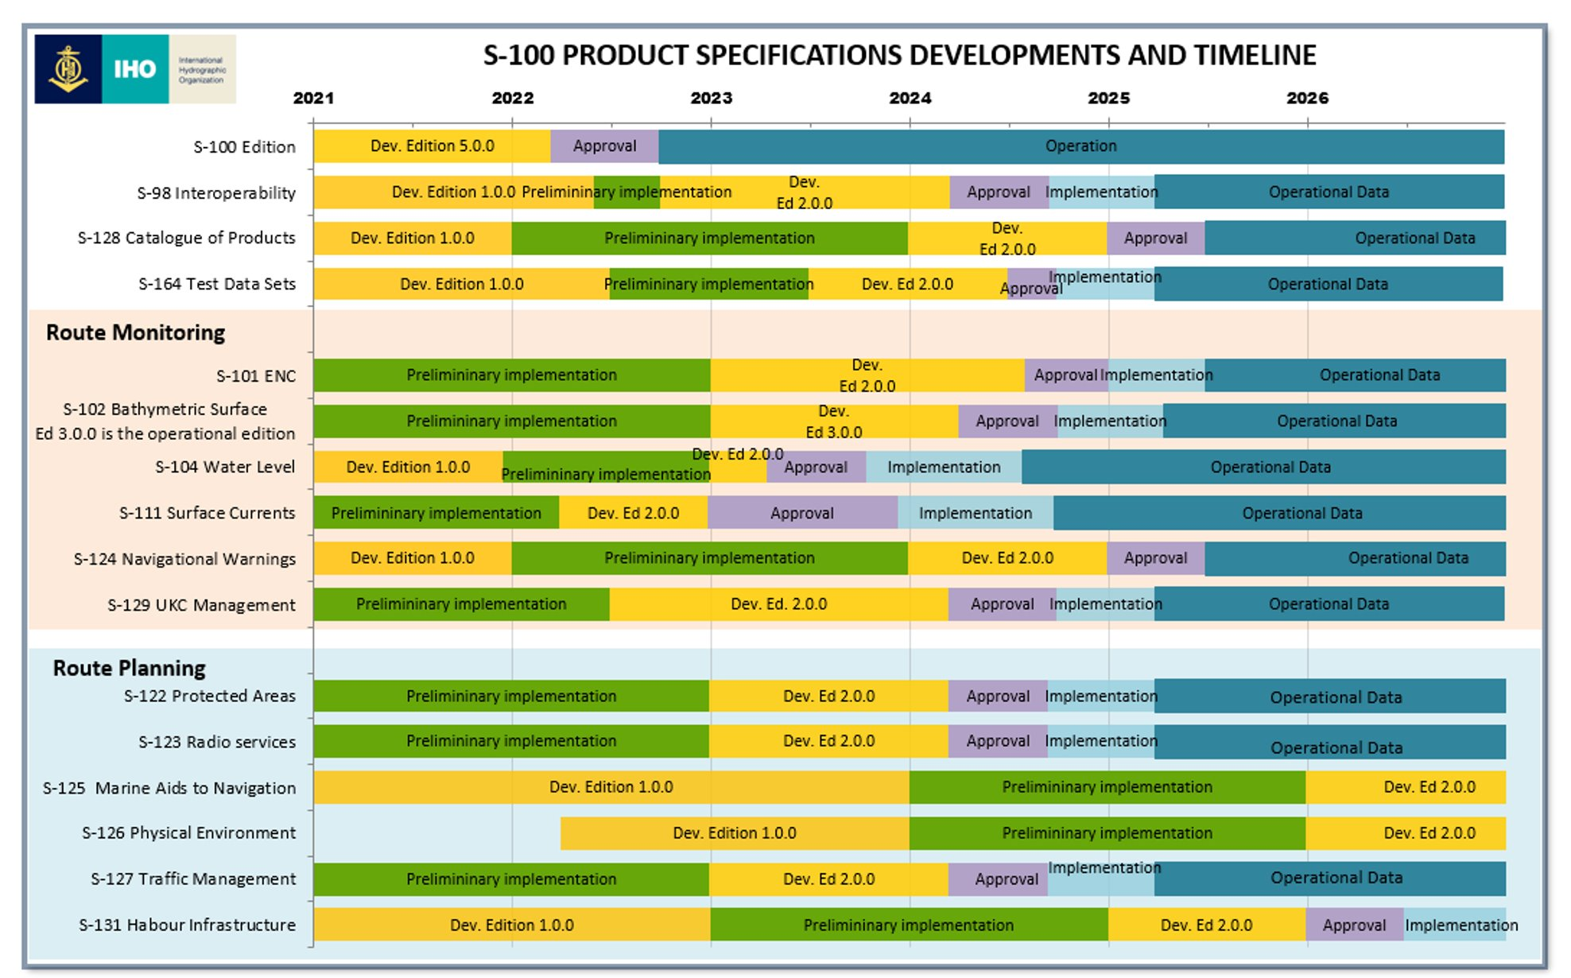
S-100 based ECDIS (IEC standard) in use from 01-01-2026

Slide 36
Status of S-99, S-100, S-101
Action points from last meeting (1):
keep track of S-101 developments and the consequences for IENCs (Cameron, Tom, René, Friedhelm, Gert, Gaël and Patrick)
Denise to reach out to Tom Bovey regarding S-501 developments to determine whether there will be similar challenges faced by S-501 regarding Interoperability with S-101. Interoperability will be an issue for S-501 also

Slide 37
Status of S-99, S-100, S-101
Action points from last meeting (2):
Check the new edition of S-52
The domain managers to mail to Jeff and to make him aware of duplications due to violations of S-99
COMEX² to replace locationMRN with the interoperability identifier and to take this change into account in the conversion guidance

Slide 38
Development of S-501
IEHG could be informed about the development of S-501 (AML, Routes, Areas, and Limits (RAL))

Slide 39
Application for new Producer Codes
https://registry.iho.int/producercode/list2.do contains new Producer Codes for S-100 based Products
Currently the S-100 list is quite short and most chart producers are only in the S-57 list in the registry
It is still unclear whether there is or will be a requirement to apply for a conversion of the existing codes

Slide 40
Interoperability and S-98
At the last meeting we decided to develop an own interoperability standard if IHO confirms that it is legally permissible for a maritime vessel to display S-401 when outside of SOLAS area

Slide 41
Interoperability and S-98, action points
The Core Group to ask for another meeting with IHO and to request a formal confirmation from IHO that certified ECDIS is allowed to use other S-100 based products when the vessel is outside of SOLAS areas.
Develop a proposal which lists the S-100 products besides S-101 and S-401, that should be taken into account for an inland specific interoperability standard until the next IEHG meeting if the answer of IHO is positive (see next slide)

Slide 42
Interoperability
IHO has reserved the PS number S-403 for the inland interoperability standard
We decided that S-403 should be based on S-98 and should at least cover S-101 and S-401
Which other products should be included?
S-402 bathymetric IENC ?
S-102 bathymetric surface (in S-98) ?
S-104 water level information for surface navigation (in S-98)?
S-111 surface currents (in S-98) ?
S-129 under keel clearance management (in S-98) ?
None of the products of S-98 has been used in inland navigation
We have to decide for each feature of each included PS under or above which features of S-401 it has to be displayed!

Slide 43
Development of S-401
IEHG has to develop
S-401 Product Specification
S-401 Data Classification and Encoding Guide (DCEG)
S-401 Feature Catalogue
S-401 Portrayal Catalogue
Conversion Guidance
S-402 Product Specification for bathymetric IENCs (vector): development will start after finalization of draft S-401
Maybe Product Specifications, FCs and PCs for overlay IENCs and basic IENCs for use with overlays
S-158:401 Recommended Validation Checks for IENCs including test cells
S-403 inland interoperability standard

Slide 44
Github repository
A GitHub repository (https://github.com/iehg) has been created
The repository is used to share all documents and items which are part of the standard
Possibility to share issues
Six repositories:
Product Specification
Feature Catalogue
Portrayal Catalogue
DCEG
Conversion Guidance
Validation Checks

Slide 45
S-401 Product Specification (Gert)
IHO has published edition 2.0.0 of the ENC Product Specification S-101 in January 2025
The S-401 PS has been compared to the 1.4.1 edition of the S-101 PS in September 2024
Since edition 1.1.0, the parts describing portrayal were added to the document. Section 9 – Portrayal has been included and is referring to the S-100 Product Specification Part 9A.
Changes compared to already published edition 1.0.0 are marked as changes. Most of these changes are coming from edition 2.0.0 of S-101
Questions: see comments in the draft
Document on the GitHub: https://github.com/IEHG/Product-Specification

Slide 46
Action points from last meeting (PS)
All regions to test edition 1.2.0 of S-401 and to submit feedback
COMEX² to try to include overlay cells in the next edition of S-401 and to report to IEHG (would have to be handled by S-98 if separate PS for overlay cells; To be discussed whether it is possible and necessary to include them in S-401)
COMEX² to align the draft with edition 2.0 of S-101, update references to IENC Encoding Guide Ed. 2.2 to Ed. 2.6 and to check all tables in the PS
Bernd to ask IHO for the copyright and disclaimer for all parts of S-101
Vitor to investigate the consequences of signing of datasets for the chart producers and for the end users
Denise and other users of overlay cells to investigate whether S-125 could be used in the future

Slide 47
S-401 Product Specification – way forward
Adoption of S-401 1.2.0 (based on S-101 edition 2.0.0) Document
Draft of S-401 edition 2.0.0 for IEHG 2026
Open questions?
Who is able to contribute?
Time line?
Action points:

Slide 48
Development of the S-401 DCEG
The draft of S-401 DCEG edition 1.2.0 has been developed based on the S-101 DCEG edition 2.0.0 All differences are marked as track changes
Inland specific Encoding Instructions have been copied from the Encoding Guide for Inland ENCs edition 2.6 All differences are marked as track changes
Questions are in the comments The comments are also containing the answers of IEHG or of the COMEX² project
Document on the GitHub:
https://github.com/IEHG/DCEG

Slide 49
Action points from last meeting DCEG
Comex² and all members of IEHG to continue the development of a DCEG for S-401 taking into account the decisions of IEHG.
All to check whether additional categories are necessary.
COMEX² to take them into account for the conversion guidance.
Denise – transfer all SCAMIN values from the encoding instructions to the feature tables
Bernd to take the decisions regarding (M), (C) and (O) and the SCAMIN values into account
Bernd to take the decision regarding the preferred encoding of time into account
Bernd to compare the S-101 DCEG 2.0.0 when it is available with the draft of the S-401 DCEG and to make the necessary changes

Slide 50
Already adopted CRs: buoy line
The Netherlands is using yellow buoys positioned in one line to indicate that a part of the waterway is blocked and it is prohibited to enter. Therefore, I have drafted this change request on behalf of Rijkswaterstaat (RWS) and is introducing a new feature 'buoyLine' with the appropriate attributes. The proposal allows other types restrictions and linestyles in the future (if necessary).
CR455
New feature buoy line needs to be registered
Proposal is in draft 11 of the DCEG and has still to be added to the FC, PC, Validation Checks
Proposed way forward:
Include the buoy line in 1.2.0 if registration is approved before the end of October
If not, publish edition 1.2.0 without buoy line and publish an edition 1.2.1 with buoy line when the registration is approved (without further meeting or written approval of IEHG)
If the registration is rejected: update the CR and take it into account for 2.0.0

Slide 51
Already adopted CRs: encoding of bridges
During the IEHG meeting of 2023, it was agreed to use the new way of encoding bridges as proposed by IHO for S-101 as soon as this proposal was stable. In the meanwhile, the feature type bridge, span opening and span fixed have been added into the S-401 FC and DCEG.
In the CR, the encoding instructions are copied in an annex from the DCEG. The new feature types 'span opening' and 'span fixed' are not introduced because they were already copied in the S-401 FC and this would make the change request too complex.
This CR 456 is the formal adoption of the new encoding of bridges in S-401 and has been accepted on 23 June 2025.
Already taken into account in DCEG and FC

Slide 52
Already adopted CRs: large and heavy cargo
On behalf of Germany I am submitting a CR to allow the encoding and display of transshipment points for lage and heavy goods.
There is no international definition of the term "large and heavy goods", but in most countries it is required to obtain a special permission if such goods are transported on the road. The thresholds are however different in different countries. Each country would have to apply it's own national definition therefore.
Inland vessels are a very good alternative to the transport on the road and the idea is to show in the IENCs where such goods can be transhipped.
The change request 454 was adopted 24 March 2025.
New elements already registered, marked yellow and purple in DCEG 11, has still to be added to the FC, PC, Validation Checks

Slide 53
Open discussions (absolute height bridges 1)
In the Netherlands, there is still a lot of discussion about the provision of information regarding the clearance height of bridges.
The future data model of RIS-NET includes the terms ABS_HEIGHT and ABS_HEIGHT_OPEN.
The values of these attributes describe the elevation of the underside of the bridge in relation to reflev, the general reference plane such as NAP, TAW etc.
Because the publications of water level are also published as values relative to revlev (NAP, TAW, etc.) it can be determined more easily, e.g. an up-to-date vertical clearance.
In short, a bridge object according to RIS-NET contains all the ingredients to get a calculated or determined vertical clearance.
The same applies to the bridge in the IENC, but it is a bit more cumbersome to determine the ABS_HEIGHT, for example, while ABS_HEIGHT actually contains the most reliably measured information.
The ABS_HEIGHT is then derivable from the sum of VERCLR + vcrval. vcrval is water level of a fixed reference level (vcrlev = MHWS) expressed in relation to revlev (NAP, TAW etc.)
For the IES 2.5 edition, additional attributes have been added to bridges, namely reflev and elevwl. The elevwl describes the water level in relation to revlev.

Slide 54
Open discussions (absolute height bridges 2)
Thus, the revlev attribute already exists in the IENC2.5.
In order to clarify the data model of RIS-NET (which will also be a described standard in the long term) and thus also the understanding of this type of information among end users, it seems reasonable to propose to introduce the concepts of ABS_HEIGHT and ABS_HEIGHT_OPEN for the IENC2.6.x as well.
The advantages of adding these two attributes are:
- the end user will be able to determine an actual clearance height less complicated,
- alignment will be achieved between the data model of RIS-NET, as a future standard, and the IENC standard.
I like to hear your feedback on this concept proposal.
Kind Regards
René

Slide 55
Open discussions (absolute height bridges 3)
Dear René,
I understand that it should be clear what is meant by 'vertical clearance' and how this height is measured or calculated. The proposed attributes are indeed added to the RIS.net concept but I'm wondering what the advantage is for the skipper/boatmaster on one hand and the ECDIS-software on the other hand. The skipper only wants to know the available height measured from the water to the bridge. Isn't it going to be a lot more difficult if we add all the other values?
BR,
Gert

Slide 56
Open discussions (absolute height bridges 4)
Thanks for your feedback. The measured and determined (= between the CEVNI D2 notice marks) elevation of the underside of the bridge is a constant value. At this moment it is not possible to encode this value in an available attribute of the bridge object. This information can indeed be calculated by summarize the value of the vertical clearance (VERCLR) and the value of the water level of the reference water level (vcrlev, vcrval) that belongs to the bridge object. The reference water level (i.e. the value of the MHWS) of the bridge object is based on reflev attribute (NAP, TAW etc).
So, you're right that duplicate information can arise when suggested extra attributes are added.
However, you must calculate the value of the height of the bottom of the bridge and there is a chance of making errors with every calculation. There is also a high chance that the required attributes will not be filled. E.g. vcrlev and vcrval have been introduced in the edition 2.5 and at this moment they are most likely not coded anywhere yet and then the calculation of the height of the bottom bridge will not be correct. As a result, it becomes difficult for the skipper to calculate a future and actual vertical clearance.
And as indicated earlier, the measured and determined height of the underside of the bridge is actually the only reliable value (or should be).

Slide 57
Open discussions (absolute height bridges 5)
The introduction of reflev and elevwl in the standard is, quite understandably, proposed by service providers who want to work with height sensors on ships (automatic navigation).
Another possible development is that in the future, actual or predicted water levels at a bridge may be made available as a service. In that case, it is very nice that the determined and measured height of the bottom of the bridge is immediately available, instead of the mandatory execution of a calculation, whereby it is very uncertain whether all the necessary attributes for that calculation are properly filled in.
BTW, I don't think there is a validation check yet that can overcome this issue; Check: "Are all the necessary attributes filled?".
If the two proposed additional attributes were to be added in the long term, it would also be an advantage that the data models of RIS-Net and IENC are harmonized and of course for the shipmaster it 'll be easier to calculate the actual and/or predicted vertical clearance.
The possible issues mentioned:
All the encoded information in existing IENCs would have to be converted
All Inland ECDIS would have to be able to calculate the geodetic height from the data in old IENCs and to calculate the clearance from the data in the new IENCs.

Slide 58
Open discussions (absolute height bridges 6)
I don't believe that these issues play a significant role because, for example, there are hardly any edition 2.5 IENC's available and no changes have been proposed that would interfere with the existing encoding. The Inland ECDIS will also continue to present the vertical cleareance (VERCLR) as the value for the safe vertical clearance.
I hope that I have clarified a few things.
Greetings René​

Slide 59
Open discussions (update information 1)
S-101 is introducing the new feature Update Information:
“The meta feature Update Information is used by the Inland ECDIS or ECS to provide, on request, a visual indication to the boatmaster of information that has changed in the System Database when an IENC Update is applied. Therefore, an associated instance of Update Information corresponding to each feature instance included in an IENC Update dataset (ER Application Profile) is mandatory for all changes that impact on navigation*. Update Information must be associated with features that have changed using the association Updated Information (see clause 25.13).
The creation of Update Information meta feature instances and the corresponding Updated Information association instances may be substantively automated in IENC production systems and associated databases".
If the creation of this meta feature and especially of the associations is automated by the chart production software it is fine, but if the associations have to be created manually, it would cause a big workload for the chart producers.

Slide 60
Open discussions (update information 2)
I am also not so sure that the information which buoy, which notice mark or which of the depth areas has been changed by an update is really so important for the boatmaster.
It is of course useful to include this feature in S-401, but should it be mandatory for updates or should it be optional?
Best regards, ​Bernd
​I agree that this feature should be optional. If the chart production software automatically creates the meta object, it should be included, but it requires a significant increase in the workload by chart producers, it is not practical to mandate its use.
Best regards, Denise
​I also agree! I'm wondering whether a skipper/boatmaster is really looking on the chart to see all the differences between the previous and current version of the chart. The extra workload isn't worth the effort.
BR, Gert

Slide 61
Open discussions (source indication)
IHO is planning to replace the simple attribute SORIND with a complex attribute souceIndication with the sub attributes reportedDate, source and sourceType.
We are currently also using SORDAT (reported date). Do you agree that we can delete SORDAT as separate simple attribute if it is included as a sub attribute in sourceIndication?
Best regards, Bernd
To be in line with S-101 and to avoid discrepancies​, I would be in favor of using the new complex attribute in S-401.
Best regards, Gaël

Slide 62
Open discussions (Meta Feature Data Coverage and display scales)
IHO is planning to replace the simple attribute SORIND with a complex attribute souceIndication with the sub attributes reportedDate, source and sourceType.
We are currently also using SORDAT (reported date). Do you agree that we can delete SORDAT as separate simple attribute if it is included as a sub attribute in sourceIndication?
Best regards, Bernd
To be in line with S-101 and to avoid discrepancies​, I would be in favor of using the new complex attribute in S-401.
Best regards, Gaël

Slide 63
Open discussions (Encoding of piles)
We want to follow S-101 as far as possible. The published draft of the S-401 DCEG is containing a rule for the encoding of piles that has been taken over from S-101: "Pile of type surface must only be used for Pile having category of pile = 6 (area of piles)."
If we keep this rule, a single pile may only be encoded as a point. I know that single piles have been​ encoded as surfaces in the IENCs for the river ​Ems for the passages of the big cruise vessels.
I would therefore propose to delete this rule and to allow the encoding of piles as points and as surfaces.
Do you agree or would you prefer to stay in line with S-101?
Best regards, Bernd
If the encoding of piles as surfaces is necessary for the safety of navigation, we need to allow it. So, I would delete the rule in the DCEG.
BR, Gert
​I agree with Gert's comment. If it is necessary for safe navgation, we should allow the encoding of piles as points and as surfaces.
Kind regards, Denise​ marked as open question in DCEG

Slide 64
Open discussions (roofed structure)
The roofed structure aggregation of S-101 only allows to associate a roof with its supporting pylons. In the published draft of the DCEG we have foreseen that it can also be used to associate the roof with the features that are covered by the roof (berth, crane, harbour facility, terminal). Normally none of them is a support of the roof and we have added them with the role of a component. Now we have been made aware that an aggregation may only have two roles. If we want a possibility to associate a roof with those features we have to define a new association and to register it in the registry.
I am not sure if it is really necessary to associate those features with the roof. It might be sufficient to see in the chart that e.g. the crane or the terminal is covered by a structure over navigable water.
What's your opinion?
Best regards, Bernd
I think that it is sufficient to chart the features under the roof without having to create an association feature.
Best regards, Denise​
I agree with Denise. Only the features under the roof should be charted. An association is not necessary because there's no 1 to 1 relationship. The roof can exist without the berth and vice versa.​ (Gert)

Slide 65
S-401 DCEG and way forward
Adoption of S-401 DCEG 1.2.0 (based on S-101 edition 2.0.0) Document
One version with all track changes and comments and one clean version?
Draft of S-401 DCEG edition 2.0.0 for IEHG 2026
Open questions?
Who is able to contribute?
Time line?
Action points:

Slide 66
S-401 Feature Catalogue
S-401 Feature Catalogue edition 1.2.0 based on S-101 edition 2.0.0 and IENC FC edition 2.6. XML-version, (Word version)
Still to do:
Open issues on the GitHub:
Issues · IEHG/Feature-Catalogue (github.com)

Slide 67
Action points from last meeting (FC), 1
COMEX² to finalize the CR for bridges as soon as the S-101 solution is stable. Multiplicity 1,* for category of opening to allow the encoding of bridges that have different opening spans. Attribute category of opening span also for the opening span and Encoding instruction: category only encoded for opening span, if more than one span and more than one categories of those spans.
Patrick to submit a CR regarding yellow buoy lines to clarify for which feature and which attributes the line style should be used.
COMEX² to check that only “diesel fuel” is used in S-401.
Denise and Bernd to change inland specific acronyms to lower case in the DCEG
Bernd to adapt the draft DCEG regarding Service Hours and Gaël to add the vessel type attribute to Service Hours in the FC.

Slide 68
Action points from last meeting (FC), 2
Friedhelm to check whether it is possible to add sub attributes to a complex attribute of another domain
Bernd to adapt the draft DCEG regarding Communication Information and the external XML
Gert and Gaël to identify the necessary associations and Gaël to encode them in the draft FC
Gaël to align the draft FC with 2.0 of S-101
S-100 representatives to solve the inconsistencies in the registry [10 2e errors in the S 100 registry 2023 10 25.docx of the meeting 2023]
The domain managers to update the attribute and enumerations of category of notice mark regarding CEVNI and the symbols

Slide 69
Open discussions on the forum (yellow buoy line)
During the last IEHG meeting, we decided to develop a new line style to indicate a yellow buoy line in the charts. This buoy line is used to separate navigable and non-navigable areas in the waterway. The line style has been developed but the question is to which feature this is related? Is a new feature necessary?​
IEHG:

Slide 70
Associations
The FC is defining the possible associations between different features
For S-101 features we have to
Delete associations with S-101 features that are not used by S-101
Check, if we need to add associations to inland specific features
For inland specific features we have to define the possible associations
The draft DCEG is containing the proposed associations
IEHG:

Slide 71
S-401 Feature Catalogue, way forward
Adoption of S-401 FC 1.2.0 (based on S-101 edition 2.0.0) XML-version
Draft of S-401 FC edition 2.0.0 for IEHG 2026
Open questions?
Who is able to contribute?
Time line?
Action points:

Slide 72
S-401 Portrayal Catalogue (Gert)
Symbols were converted according the S100 SVG Tiny profile.
New Brazilian symbols under development
Received an approval of HSSC for the bulk registration = in progress
LUA scripts are under development
Copy/pasted S-101 scripts
Edited S-101 scripts for S-401
Developed inland specific scripts
How to test the individual scripts?

Slide 73
Portrayal Catalogue (Gert)
Still to do:
Conversion of the CS
Solution for features on the same position
Open issues on the GitHub:
Issues · IEHG/Portrayal-Catalogue (github.com)

Slide 74
Action points from last meeting, PC (1)
COMEX² with the support of Mikan to
continue as proposed in the presentation when a stable PCB is available, or continue with the manual adaptation. Contribution of all members via the discussion forum
develop test data based on the input from Laszlo and René
amend the Conditional Symbologies on the basis of available CS (OpenCPN) or CS of other manufacturers. If no machine readable inland CS can be obtained, check if the maritime CS can be amended manually
consider real world pictures and complex attributes as possible solutions for the display of multiple notice marks at the same spot
create the XML for the PC (partly done but CS have still to be converted to LUA scripts).
Ensure that top marks are displayed with colour (as in the current PresLib)

Slide 75
Action points from last meeting, PC (2)
All members to inform Gert if they are able to contribute to the development of the Portrayal Catalogue
Tom, Friedhelm and Cameron to check if they can provide testing possibilities for LUA scripts
Gert to reach out to Dave Grant for LUA scripting testing
All members that submit proposals with new symbols to provide the symbols in SVG format themselves or to provide them in a different format to Claudia Heckert for conversion to SVG. They have to take the new guideline and the form for symbols into account
Bernd to publish the amended Presentation Library on the website

Slide 76
S-401 Portrayal Catalogue, way forward
Adoption of S-401 PC 1.2.0 (based on S-101 edition 2.0.0) ?
Draft of S-401 PC edition 2.0.0 for IEHG 2026
Open questions?
Who is able to contribute?
Who will improve the LUA scripts if necessary?
Who will provide a testing possibility?
Time line?

Slide 77
Development of S-401 test cells
Action point from last meeting:
Tom and Gert to discuss conversion of the existing test cells following the meeting

Slide 78
Development of S-401 test cells
S-401 test cells edition 1.2.0
Draft of S-401 test cells edition 2.0.0 for IEHG 2026
Open questions?
Who is able to contribute?
Time line?

Slide 79
S-401 Alert catalogue
The last meeting came to the following conclusions:
Europe: Inland ECDIS standard defines all kind of alarms, there’s no need to focus on an ‘alarm catalogue’
US and Brazil: no immediate need
The meeting could discuss whether they are still valid

Slide 80
S-158:401 Validation Checks
The meeting could discuss the first draft of the S-158:401 Validation Checks and answer open questions
Cover page Tables available on github
The draft has to be updated in accordance with the decisions regarding the PS, DCEG and FC

Slide 81
S-57 to S-101 converter development
Action points from last meeting:
Gert and Gaël to start working on the inland specific features
Tom and Gert to start working on the copied and amended features (check all existing maritime rules). The first draft of S-101 to S-57 conversion guidance is available as S-65 Annex C
Comex² to take the change from catach_10 (anchorage for pushing-navigation vessels) in IENC 2.5 to categoryOfAnchorage 16 (anchorage for pushing-navigation vessels) in S-401 into account for the Conversion Guidance
COMEX² to take the changes regarding CONDTN 3, STATUS 18 and InDispute in CR 426 into account for the Conversion Guidance

Slide 82
Conversion guidance
Draft avaibale on github
Stable version of the FC and DCEG are needed
Is a conversion guidance S-401 to S-57 necessary?

Slide 83
S-401 conclusions and timeline
Action point from last meeting:
Start with the development of the validation checks for S-401
The meeting could discuss proposals for a description of options for the transitional period

Slide 84
S-401 transitional period
It will not be possible to switch from S-57 to S-401 on a specific date (replacement of all existing IENCs and all existing ECS/Inland ECDIS, at least within a region)
We will therefore need a transitional period, in which either
the chart producers will provide S-57 based IENCs and S-401 IENCs or
the manufacturers of ECS/Inland ECDIS will provide dual fuel applications that can read S-57 based IENCs and S-401 IENCs
IEHG decided in 2025 that decisions regarding the transitional period have to be taken on regional level
IEHG could develop a description of options for the transitional period

Slide 85
S-401 conclusions and timeline
Is the plan to adopt S-401 edition 2.0.0 in October 2026 confirmed?
Which parts could be delayed?
Open questions?
Who is able to contribute?
Time line?

Slide 86
S-201 and S-125
IALA is working on Product Specifications for Aids to Navigation (AtoN) Information (S-201) and for Navigation Services (S-125). The meeting could be informed about the status of development

Slide 87
The Bathymetric Contour Overlay (S-402)
S-402 has been reserved by IHO for the Bathymetric Contour Overlay for Inland ENC Product Specification as requested by IEHG. The existing Product Specification for bathymetric Inland ENCs and S-401 should be the basis for the development of S-402. IEHG has decided to start with the development of S-402 when the corresponding parts of S-401 have been adopted.

Slide 88
Annual report to HSSC
Action point from last meeting:
Denise and Bernd to prepare a report for the next HSSC taking into account the developments regarding S-98 Status: Done, action point closed
New report for the next meeting:
Who, when?

Slide 89
Information document on Inland ENCs
IEHG has developed a document that provides information on Inland ENCs and the relation and the differences to maritime ENCs
The document (available on the ienc.openecis.org website) can be used by every member of IEHG for presentations, discussions, explanations
All members of IEHG are invited to submit proposals for amendments of the information document on Inland ENCs
Information (EN)
Información (SP)
Información (PT)
Information (DE)
Informacion (FR)
Informacion (NL)

Slide 90
Information document on Inland ENCs
Action points from last meeting:
All members of IEHG are invited to submit proposals for amendments of the information document on Inland ENCs (Inland ENC.ppt on the IEHG website)
The Core Group to update regulatory status, coverage and contact persons

Slide 91
Operation of Web Services (1)
Future operation of the ienc.openecdis.org website
now hosted by the European Committee for drawing up standards in the field of inland navigation (CESNI)
Proposals for improvements?
https://ienc.openecdis.org

Slide 92
Operation of Web Services (2)
Discussion forum
Due to internal regulations of USACE the discussion forum has to be moved to a new platform
Proposals?
APAN - Sign In

Slide 93
Operation of Web Services (3)
IENC domain in the registry of IHO
http://registry.iho.int

Slide 94
Any other business
How to encourage other countries to join IEHG? South America / Asia
Any other business?
Departures

Slide 95
Next Meeting
Do we need an IEHG meeting next year?
Do we need a physical meeting or is an online meeting sufficient?
where and when ? Last meetings: 2015 China, 2017 Brazil, 2019 US, 2021 Europe, 2022 online, 2023 US, 2024 China, 2025 Austria
week of October 19th or November 9th? The S-100WG meeting date has already been set for the week of September 21st, 2026. (DC meeting November 9th)
Changes to the agenda of next meeting?

Slide 96
Thank you all for participating!

